Slide 1
Lesson 3.17
External Communication Requirements
CGPRT(W) : Ensuring Clean Seas and Coasts in Western Region ……

Slide 2
Objective
To explore the various types of media and their requirements
To consider the need for a Media relations plan
To consider how best to manage the media
To consider how to prepare for interviews
To consider how to prepare for news conferences
CGPRT(W) : Ensuring Clean Seas and Coasts in Western Region ……

Slide 3
Two Plans
Communications plan
  Response team
  Response community
  Senior administrators/Ministers
  Regional and international contacts
Media relations plan
Media
Public
CGPRT(W) : Ensuring Clean Seas and Coasts in Western Region ……

Slide 4

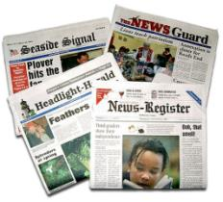







The Media
CGPRT(W) : Ensuring Clean Seas and Coasts in Western Region ……

Slide 5
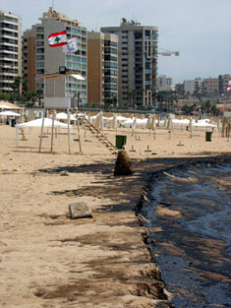
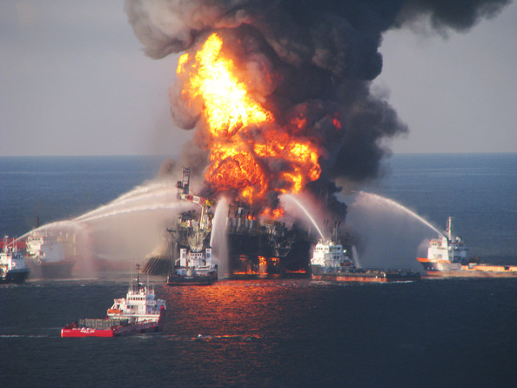
Highly Visible
CGPRT(W) : Ensuring Clean Seas and Coasts in Western Region ……

Slide 6
Crisis – Good news?
It has a controversial flavour
There is damage and a number of potential victims
It evokes collective emotions and imagination
It makes a good story
Enhances or supports other stories
There is always available space in the next issue of the newspaper, next TV or radio broadcast
CGPRT(W) : Ensuring Clean Seas and Coasts in Western Region ……

Slide 7
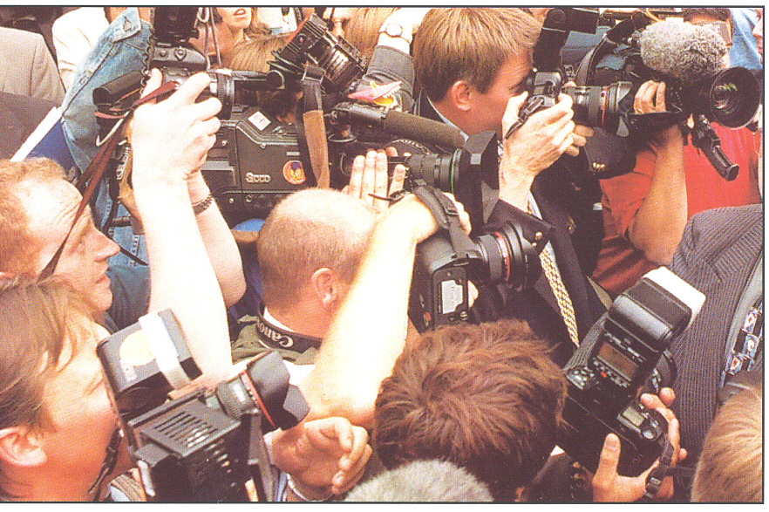
The Media
The role of the media is to:
Inform
Comment
Scrutinize
Communicate
The media can
serve as a resource for information dissemination
CGPRT(W) : Ensuring Clean Seas and Coasts in Western Region ……

Slide 8

Types of Media
Print
Daily, weekly, monthly
Local, national or international
In-depth reporting
Require detailed information
Require background information
Use of graphics or pictures
Must meet deadlines
CGPRT(W) : Ensuring Clean Seas and Coasts in Western Region ……
Notes:
8

Slide 9

Types of Media
Television
Rolling 24/7 coverage
Local, national and international
Message is very visual
Information spots are very short
Interviews
News conferences
CGPRT(W) : Ensuring Clean Seas and Coasts in Western Region ……
Notes:
9

Slide 10

Types of Media
Radio
Tight deadlines
Hourly or half-hourly reports
Frequent updates
On the spot interviews
Reports are brief
Features only the most important facts
Emphasis on what is happening now
Includes live sounds
CGPRT(W) : Ensuring Clean Seas and Coasts in Western Region ……
Notes:
10

Slide 11
Types of Media
Internet
Social networks are a new phenomena
Communication strategies need to be reviewed
24/7 worldwide audience
Rapid reaction, comment, dialogue and comment from many sources
  Blogs and non-news outlets
CGPRT(W) : Ensuring Clean Seas and Coasts in Western Region ……
Notes:
11

Slide 12
Types of Media
Social media platforms/tools
Social networks
  Facebook, MySpace, Google+, etc.
Micro-blogs
  Twitter, etc.
Blogs
  WordPress, Blogspot, etc.
Audio, video and image sharing
  YouTube, Flickr, Instagram, etc.
CGPRT(W) : Ensuring Clean Seas and Coasts in Western Region ……
Notes:
12

Slide 13
Types of Media
Social media platforms/Tools (cont’d)
Crowd-based platforms
  Crowdmap, etc
Social media dashboards
  Tweetdeck, Hootsuite, Addictomatic, etc.
Social book marking sites
  Delicious, StumbleUpon, etc.
CGPRT(W) : Ensuring Clean Seas and Coasts in Western Region ……
Notes:
13

Slide 14
Managing the Media
Media training
Credible and caring spokesperson
Awareness of media requirements – tools
Sufficient staff to meet media’s expectations
Preparation is key – plan
CGPRT(W) : Ensuring Clean Seas and Coasts in Western Region ……

Slide 15
The Media at the Scene
Positive aspects
counteract rumours spreading
convey information that can ease public fear/anxiety
follow the event, explain and examine the circumstances and responsibilities
CGPRT(W) : Ensuring Clean Seas and Coasts in Western Region ……

Slide 16
The Media at the Scene
Negative aspects
the competitive nature of making news can affect the judgement of the reporters, breaking codes of ethics
can make the operation more difficult
need to provide access with time and H&S issues
media unawareness/ignorance can lead to an unprofessional way of working and behaving in the field
CGPRT(W) : Ensuring Clean Seas and Coasts in Western Region ……

Slide 17
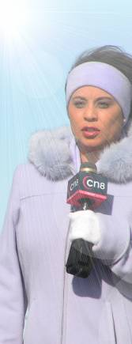
Managing the Media
Effectiveness of the media during an incident
Unfolding nature of information
Size of the media contingent
Briefings/updates
Press releases
Additional tools
Media facilities
Media tours/escort
CGPRT(W) : Ensuring Clean Seas and Coasts in Western Region ……

Slide 18
Public Communications Plan
Objective:
To quickly assemble a structured team to support and advise the organization’s emergency response leader with the management of information, for the purpose of warning and informing the public and managing public perception as part of the wider incident response.
CGPRT(W) : Ensuring Clean Seas and Coasts in Western Region ……

Slide 19
Public Communications Plan
The public communications plan should detail
initial actions for the different roles in such as:
An agreed process for releasing media information which includes an agreed definition of “non-contentious” messaging
An agreed “initial statement” (not “holding statement” – “initial” infers first of many, “holding” infers you have something to hide)
CGPRT(W) : Ensuring Clean Seas and Coasts in Western Region ……

Slide 20
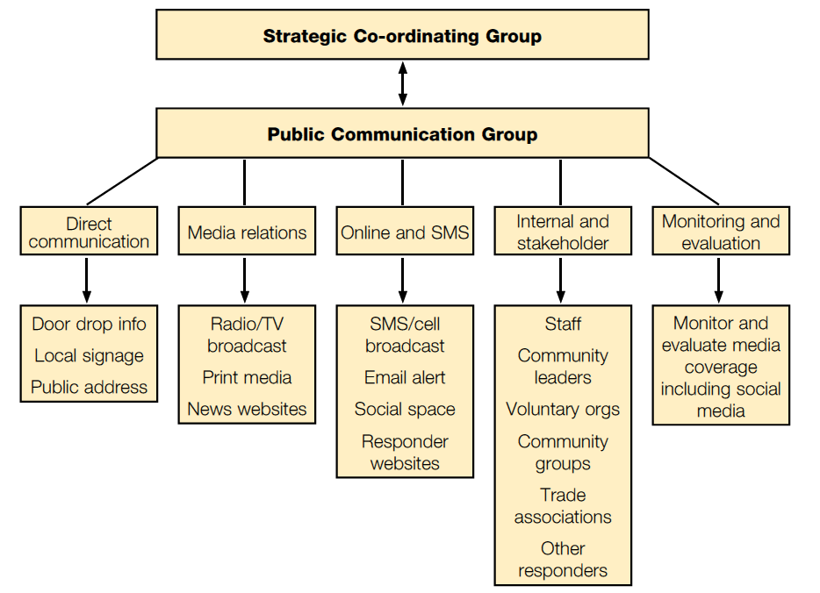
CGPRT(W) : Ensuring Clean Seas and Coasts in Western Region ……

Slide 21
News Releases
Use simple, clear language
Stick to facts
Do NOT speculate
Express regret, if appropriate
Emphasize positive points
Understandable language – no jargon!
Identify media focal point and contact details
CGPRT(W) : Ensuring Clean Seas and Coasts in Western Region ……

Slide 22

Media Interviews
Key elements
Preparation
Positioning statement
Use of quotes and sound bites
On the record/off the record
Handling difficult questions
Looking and acting the part
CGPRT(W) : Ensuring Clean Seas and Coasts in Western Region ……

Slide 23
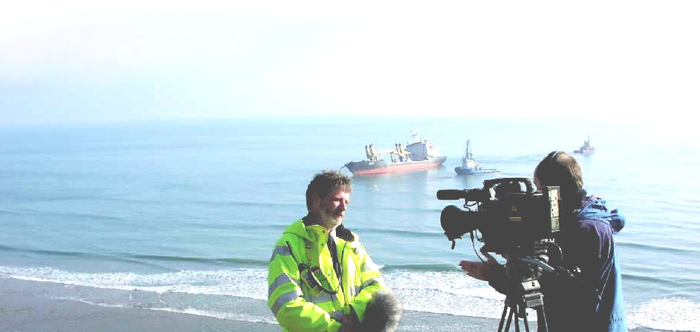
One-to-one interviews
Generally fall into two categories
On the spot/stand up interviews
Pre-arranged personal interviews
CGPRT(W) : Ensuring Clean Seas and Coasts in Western Region ……

Slide 24
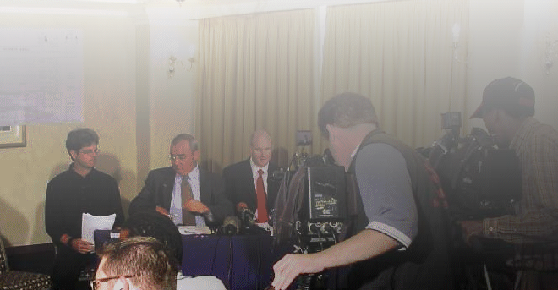
News conferences
Key points
Is everyone ready?
Hand out a statement
Tape yourself
Keep track of names and organizations
Say if you don’t have an answer
Be punctual
If you promise to provide further information ensure you provide it
CGPRT(W) : Ensuring Clean Seas and Coasts in Western Region ……

Slide 25
Common Questions
What happened?
How did it happen?
When, where, why did it happen?
Who is involved?
What caused it?
What is being done about it?
Who is to blame?
Who is responsible/liable?
Who is going to pay the clean-up costs?
CGPRT(W) : Ensuring Clean Seas and Coasts in Western Region ……

Slide 26
Common Questions
What operations are going on?
Has it happened before?
Was it preventable?
Are there any witnesses?
What is the impact?
What are the health and safety risks?
Is anyone injured?
Do we need to evacuate?
How much will it cost?
CGPRT(W) : Ensuring Clean Seas and Coasts in Western Region ……

Slide 27
News Conference – Do
Establish positive relations with the media
Be prepared
Stick to your area of expertise
If you don’t know… say you don’t know, but will find out.
Anticipate the questions you’ll be asked and prepare your answers beforehand
State the important facts at the beginning
Be helpful, friendly, and courteous
CGPRT(W) : Ensuring Clean Seas and Coasts in Western Region ……

Slide 28
News Conference – Do
Be clear, concise, factual in your responses.
Put the story in context.
Ask for questions to be repeated if you
don’t understand them.
Define the problem.
Keep your message brief and to the point.
Tell the truth, don’t hide bad news.
Stick to your message and return to
it whenever you can.
CGPRT(W) : Ensuring Clean Seas and Coasts in Western Region ……

Slide 29
News Conference – Do not
Give more than is needed.
Speculate, make predictions or give opinions. Stick to the facts as they are known.
Lie or be evasive.
Go “off the record.” If you say it, expect to see or hear it.
Respond to an inquiry if it is not your expertise. Recommend a proper source, if possible.
CGPRT(W) : Ensuring Clean Seas and Coasts in Western Region ……

Slide 30
News Conference – Do not
Be sarcastic.
Argue with a reporter.
Lose your cool.
Jump at media questions. Take your time and think before answering.
Let the reporter lead you.
CGPRT(W) : Ensuring Clean Seas and Coasts in Western Region ……
Notes:
30

Slide 31
Summary
In this lesson we have considered:
the various types of media and their requirements
the need for a Media relations plan
how best to manage the media
how to prepare for interviews
how to prepare for news conferences
CGPRT(W) : Ensuring Clean Seas and Coasts in Western Region ……

Slide 32
Any questions?
CGPRT(W) : Ensuring Clean Seas and Coasts in Western Region ……

